Slide 1
COMP 4290
Week 2 - Wednesday

Slide 2
Last time
What did we talk about last time?
Authentication
Challenge-response
Passwords
Started biometrics

Slide 3
Questions?

Slide 4
Project 1

Slide 5
Adam Garantche Presents

Slide 6
Biometrics

Slide 7
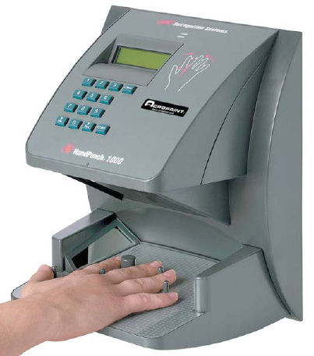
Other biometrics
Hand geometry readers measure the shape of your hand
Keystroke dynamics are the patterns that you use when typing
  Users are quite distinctive, but distractions and injuries can vary patterns a lot
Combinations of different biometrics are sometimes used
DNA sequencing is not (yet) fast enough to be used for authentication
Researchers are finding new biometrics to use

Slide 8
Problems with biometrics
People assume that they are more secure than they are
Attacks:
  Fingerprints can be lifted off a champagne glass
  Voices can be recorded
  Iris recognition can be faked with special contact lenses
Both false positives and false negatives are possible
Disabilities can prevent people from using some kinds of biometrics
It's possible to tamper with transmission from the biometric reader
Biometric characteristics can change
Identical twins sometimes pose a problem

Slide 9
False positives and false negatives
 | Is the Person Claimed | Is Not the Person Claimed
Test is Positive | a | b
Test is Negative | c | d
Sensitivity is positive results among correct matches
  a / (a + c)
Specificity is negative results among people who are not sought
  d / (b + d)
Accuracy is how often the test is correct
  (a + d) / (a + c + b + d)
Prevalence is how common a condition is
  (a + c) / (a + c + b + d)

Slide 10
Tokens
Tokens are physical objects you possess
  Keys
  Badges
  Cell phones
  RFIDs
Passive tokens take no action and do not change
  Example: photo ID
Active tokens change or interact with surroundings
  Examples: RFID or magnetic card

Slide 11
Static and dynamic tokens
The value of a static token does not change
  Examples: Keys, passports, RFIDS
  Static tokens are better for onsite authentication and may be easy to forge for remote authentication
Dynamic tokens have values that change
  Examples: RSA SecurID, Battle.net Authenticator
  Every 60 seconds, it displays a different code

Slide 12
Multifactor authentication
More than one form of authentication may provide increased security
  You may need to sign on with your password and with a code generated by an RSA SecurID
  They often need two forms of ID when you're getting a driver's license
Two-factor authentication is now common for many platforms
  Often they only ask for the second form of authentication if the computer has not logged on before
Multifactor authentication is probably more secure, but it adds complexity and possibly annoyance

Slide 13
Federated identity management
It's annoying to sign on to lots of different services with lots of different authentication mechanisms
Federated identity management schemes connect a variety of different services with one authentication method
  Example: free access to journals because you're logged onto Otterbein computers
Single sign-on is similar, allowing you to log in once, with services sharing authentication information
  Examples: logging onto Meetup.com with Facebook or Google credentials

Slide 14
Access Control

Slide 15
Access control
Subjects are human users or programs that are executing on their behalf
Objects are things that actions can be performed on
  Files
  Database fields
  Directories
  Hardware devices
Access modes are the different ways that access can be done: read, write, modify, delete, etc.
Access control is the process of managing the access modes that subjects can have on objects

Slide 16
Access control goals
Check every access
  The user may no longer have rights to a resource
  The user may have gained rights
Enforce least privilege
  Least privilege means you get the bare minimum to get your job done
Verify acceptable usage
  Access to an object is not enough: Some actions might be legal and others illegal

Slide 17
Access control issues
Many issues come up with access control
Do the correct people have the correct rights? Have statuses changed?
Granularity is the how specifically you can control rights
  Maybe you can only give complete rights to an object, not read-only rights
An audit log tracks who performed what kinds of accesses
Limited privilege tries to keep accesses from doing big damage
  Example: sudo in Linux

Slide 18
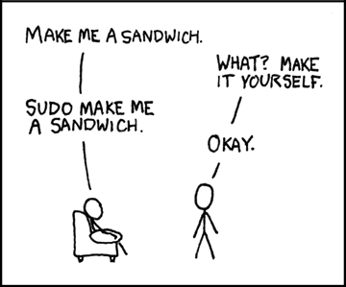
sudo
It is possible to temporarily use another user’s permissions in Unix using the command sudo
Users can be given special access to files or commands they normally could not access
An administrator can run at a normal privilege level and only occasionally run commands using higher privileges
This strategy prevents the whole system from being corrupted if the administrator gets a virus

Slide 19
Directory based approaches
Create a directory that lists all the objects a given user can access and their associated rights:
  Examples: read, write, execute, own
The own right gives the user the ability to grant others rights to that object
Problems:
  Directories can become large
  How is access revoked?
  What if two files in different locations in the system have the same name?

Slide 20
Access control lists
Listing all the objects a user can access can take up too much space
An alternative is to list all the users that have rights for a specific object
Most objects only have a few legal users
Wild cards can make the situation easier
  Read access can be granted to everyone

Slide 21
Access control matrices
Both directories and access control lists are equivalent
Different implementations are used for different kinds of efficiency
We can also imagine a matrix that holds all subjects and all objects
Although it is far too inefficient for most systems to be implemented this way, security researchers sometimes use this model for theoretical purposes
  Can you determine if some sequence of operations could leak read access to your file?
  Nope, it’s impossible!

Slide 22
Access control matrix example
 | Objects
Subjects | file 1 | file 2 | process 1 | process 2
process 1 | read, write, own | read | read, write, execute, own | write
process 2 | append | read, own | read | read, write, execute, own

Slide 23
Rights
A few possible rights:
  Read
  Write
  Execute
  Own
  Anything else that is useful?
Some rights allow users to change the rights of others

Slide 24
Brightspace system
What would the access control matrix look like for the Brightspace gradebook system?

Slide 25
Ticket out the Door

Slide 26
Upcoming

Slide 27
Next time…
Finish access control
Cryptography basics

Slide 28
Reminders
Read Section 2.3
Work on Project 1
Work on Assignment 1

